Slide 1
Data Link Control

Slide 2
11-1 FRAMING
The data link layer needs to pack bits into frames, so that each frame is distinguishable from another. Our postal system practices a type of framing. The simple act of inserting a letter into an envelope separates one piece of information from another; the envelope serves as the delimiter.
Topics discussed in this section:
Fixed-Size Framing
Variable-Size Framing
11.<number>

Slide 3

Figure 11.1 A frame in a character-oriented protocol
11.<number>

Slide 4

Figure 11.2 Byte stuffing and unstuffing
11.<number>

Slide 5

Note
Byte stuffing is the process of adding 1 extra byte whenever there is a flag or escape character in the text.
11.<number>

Slide 6

Figure 11.3 A frame in a bit-oriented protocol
11.<number>

Slide 7
Note
Bit stuffing is the process of adding one extra 0 if 011111 is encountered in data, so that the receiver does not mistake
the pattern 0111110 for a flag.
11.<number>

Slide 8

Figure 11.4 Bit stuffing and unstuffing
11.<number>

Slide 9
11-2 FLOW AND ERROR CONTROL
The most important responsibilities of the data link layer are flow control and error control. Collectively, these functions are known as data link control.
Topics discussed in this section:
Flow Control
Error Control
11.<number>

Slide 10
Note
Flow control refers to a set of procedures used to restrict the amount of data
that the sender can send before
waiting for acknowledgment.
Aka: Don’t overwhelm the receiver!
11.<number>

Slide 11
Note
Error control in the data link layer is based on automatic repeat request, which is the retransmission of data.
11.<number>

Slide 12
11-3 PROTOCOLS
Now let us see how the data link layer can combine framing, flow control, and error control to achieve the delivery of data from one node to another.
11.<number>

Slide 13

Figure 11.5 Taxonomy of protocols discussed in this chapter
11.<number>

Slide 14
11-4 NOISELESS CHANNELS
Let us first assume we have an ideal channel in which no frames are lost, duplicated, or corrupted. We introduce two protocols for this type of channel.
Topics discussed in this section:
Simplest Protocol
Stop-and-Wait Protocol
11.<number>

Slide 15

Figure 11.6 The design of the simplest protocol with no flow or error control
11.<number>

Slide 16
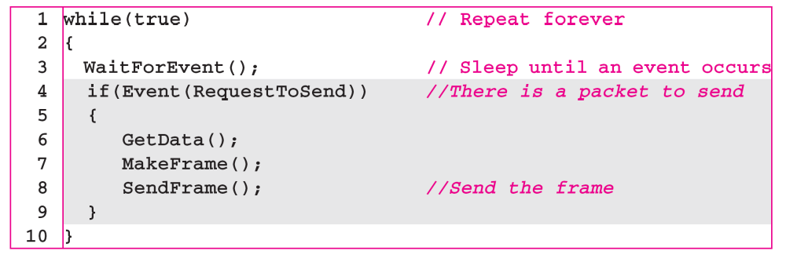
Algorithm 11.1 Sender-site algorithm for the simplest protocol
11.<number>

Slide 17
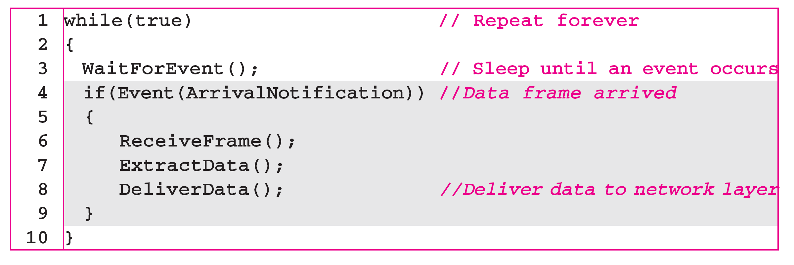
Algorithm 11.2 Receiver-site algorithm for the simplest protocol
11.<number>

Slide 18

Figure 11.7 Flow diagram for Example 11.1
11.<number>

Slide 19

Figure 11.8 Design of Stop-and-Wait Protocol
11.<number>

Slide 20
Algorithm 11.3 Sender-site algorithm for Stop-and-Wait Protocol
11.<number>

Slide 21
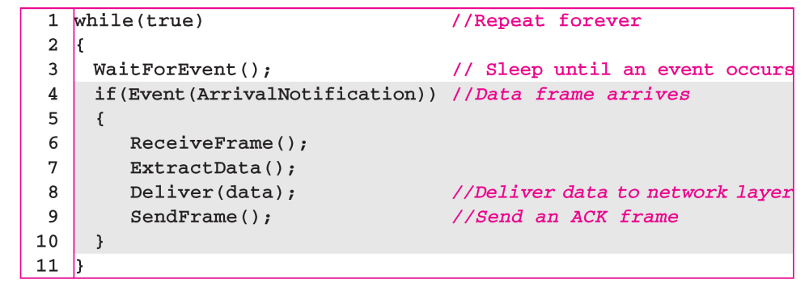
Algorithm 11.4 Receiver-site algorithm for Stop-and-Wait Protocol
11.<number>

Slide 22

Figure 11.9 Flow diagram for Example 11.2
11.<number>

Slide 23
11-5 NOISY CHANNELS
Although the Stop-and-Wait Protocol gives us an idea of how to add flow control to its predecessor, noiseless channels are nonexistent. We discuss three protocols in this section that use error control.
Topics discussed in this section:
Stop-and-Wait Automatic Repeat Request (ARQ)
Go-Back-N Automatic Repeat Request
Selective Repeat Automatic Repeat Request
11.<number>

Slide 24
Note
In Stop-and-Wait ARQ, the acknowledgment number always announces in modulo-2 arithmetic the sequence number of the next frame expected.
11.<number>

Slide 25

Figure 11.10 Design of the Stop-and-Wait ARQ Protocol
11.<number>

Slide 26
Stop-and-Wait ARQ Overview
Sender waits “reasonable” amount of time for ACK
  Thus Sender needs a countdown timer
  Start the timer when a packet is sent
  retransmits if no ACK received within the timeout period
if pkt (or ACK) just delayed (not lost):
  retransmission will create duplicate packet
  Thus it requires packet sequence number and ack number to be used
  Only two numbers are used: 0, 1
Receiver’s Ack number is what he is expected next
  After receiving Pkt 0, sends back ACK 1
  After receiving Pkt 1, sends back ACK 0
Transport Layer
3-<number>

Slide 27
Reliable data transfer: getting started
We’ll:
use finite state machines (FSM) to specify sender, receiver
event causing state transition
actions taken on state transition
state: when in this “state” next state uniquely determined by next event
state
1
state
2
event
actions
Some notations:
udt_send(packet): send the packet through the underlying unreliable channel
udt_recv(packet): receive a packet from the underlying unreliable channel
Λ : means do no action

Slide 28
stop and wait ARQ sender
rdt_send(data)
udt_rcv(rcvpkt) &&
( corrupt(rcvpkt) ||
isACK(rcvpkt,0) )
sndpkt = make_pkt(0, data, checksum)
udt_send(sndpkt)
start_timer
udt_rcv(rcvpkt)
Λ
Λ
Wait for
call 0from
above
Wait for ACK1
timeout
udt_send(sndpkt)
start_timer
udt_rcv(rcvpkt)
&& notcorrupt(rcvpkt)
&& isACK(rcvpkt,0)
udt_rcv(rcvpkt)
&& notcorrupt(rcvpkt)
&& isACK(rcvpkt,1)
stop_timer
stop_timer
Wait for ACK0
Wait for
call 1 from
above
timeout
udt_send(sndpkt)
start_timer
udt_rcv(rcvpkt)
rdt_send(data)
Λ
udt_rcv(rcvpkt) &&
( corrupt(rcvpkt) ||
isACK(rcvpkt,1) )
sndpkt = make_pkt(1, data, checksum)
udt_send(sndpkt)
start_timer
Λ
From textbook: Computer Networking: A Top Down Approach Featuring the Internet,
J. Kurose & K. Ross, Addison Wesley

Slide 29
stop and wait ARQ receiver
Receiver does not have time-out issue
udt_rcv(rcvpkt) && notcorrupt(rcvpkt)
&& has_seq0(rcvpkt)
extract(rcvpkt,data)
deliver_data(data)
sndpkt = make_pkt(ACK1, chksum)
udt_send(sndpkt)
udt_rcv(rcvpkt) &&
(corrupt(rcvpkt) ||
has_seq0(rcvpkt))
udt_rcv(rcvpkt) &&
(corrupt(rcvpkt) ||
has_seq1(rcvpkt))
Wait for
0 from below
Wait for
1 from below
receiver FSM
udt_send(sndpkt)
udt_send(sndpkt)
udt_rcv(rcvpkt) && notcorrupt(rcvpkt)
&& has_seq1(rcvpkt)
extract(rcvpkt,data)
deliver_data(data)
sndpkt = make_pkt(ACK0, chksum)
udt_send(sndpkt)
3-<number>

Slide 30
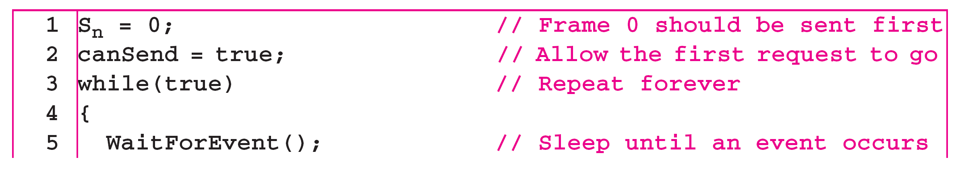
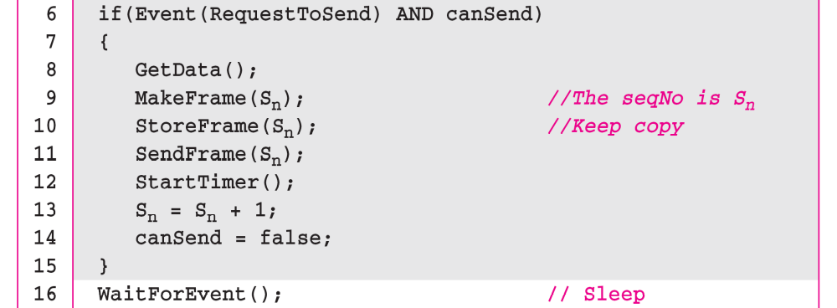
Algorithm 11.5 Sender-site algorithm for Stop-and-Wait ARQ
Modulo-2 addition
(continued)
11.<number>

Slide 31
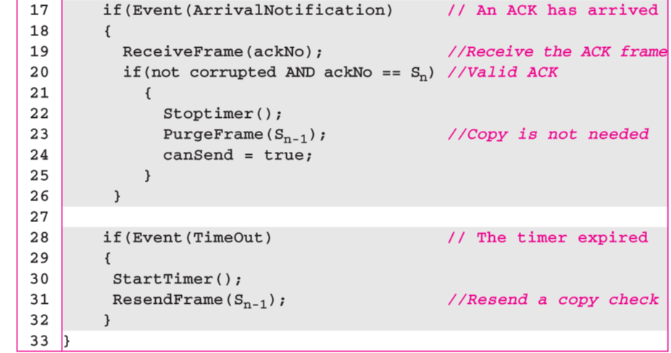
Algorithm 11.5 Sender-site algorithm for Stop-and-Wait ARQ
(continued)
11.<number>

Slide 32
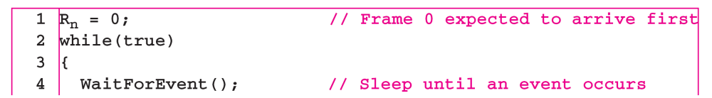
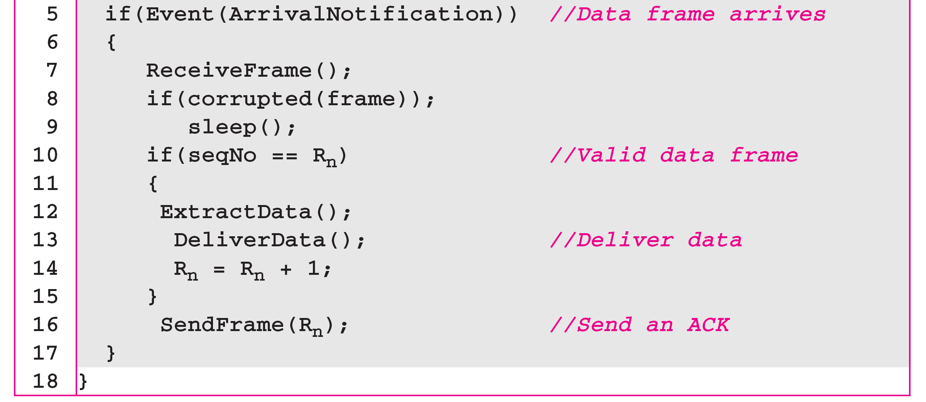
Algorithm 11.6 Receiver-site algorithm for Stop-and-Wait ARQ Protocol
Modulo-2 addition
R_{n} is the sequence number of
the next packet expected
11.<number>

Slide 33

Figure 11.11 Flow diagram for Example 11.3
11.<number>

Slide 34
Stop-and-wait operation
sender
receiver
first packet bit transmitted, t = 0
first packet bit arrives
RTT
last packet bit arrives, send ACK
ACK arrives, send next
packet, t = RTT + L / R
L: packet bit length
R: link bandwidth (bps)
Utilization = L/R / (RTT+L/R)

Slide 35
Example 11.4
Assume that, in a Stop-and-Wait ARQ system, the bandwidth of the line is 1 Mbps, and 1 bit takes 20 ms to make a round trip. If the system data frames are 1000 bits in length, what is the utilization percentage of the link?
Solution
L = 1000 bits, R = 1Mbps, RTT = 20ms
Utilization = 1/ 21 = 4.8%
For this reason, for a link with a high bandwidth or long delay, the use of Stop-and-Wait ARQ wastes the capacity of the link.
11.<number>

Slide 36
Pipelining: increased utilization
sender
receiver
first packet bit transmitted, t = 0
last bit transmitted, t = L / R
first packet bit arrives
RTT
last packet bit arrives, send ACK
last bit of 2nd packet arrives, send ACK
last bit of 3rd packet arrives, send ACK
ACK arrives, send next
packet, t = RTT + L / R
Increase utilization
by a factor of 3!
Utilization = 3*L/R / (RTT+L/R)
Transport Layer
3-<number>

Slide 37
Example 11.5
What is the utilization percentage of the link in Example 11.4 if we have a protocol that can send up to 15 frames before stopping and worrying about the acknowledgments?
Solution
11.<number>

Slide 38

Pipelined protocols
Pipelining: sender allows multiple, “in-flight”, yet-to-be-acknowledged pkts
  range of sequence numbers must be increased
  buffering at sender and/or receiver
Two generic forms of pipelined protocols:
  go-Back-N, selective repeat
Transport Layer
3-<number>

Slide 39

Figure 11.12 Send window for Go-Back-N ARQ
11.<number>

Slide 40
Note
The send window is an abstract concept defining an imaginary box of size 2^{m} − 1 with three variables: Sf, Sn, and S_{size}.
The send window can slide one
or more slots when a valid acknowledgment arrives.
Cumulative ACK
ACK(n): ACKs all pkts up to and include seq # n-1 have been received may receive duplicate ACKs (see receiver)
A single timer for the oldest transmitted but un-acked pkt
timeout: retransmit all pkts in window (up to N packets)
11.<number>

Slide 41

Figure 11.13 Receive window for Go-Back-N ARQ
11.<number>

Slide 42
Note
The receive window is an abstract concept defining an imaginary box of size 1 with one single variable R_{n}.
The window slides when a correct frame has arrived; sliding occurs one slot at a time.
out-of-order pkt:
  discard (don’t buffer) -> no receiver buffering!
  Re-ACK pkt with highest in-order seq #
11.<number>

Slide 43
Note
Stop-and-Wait ARQ is a special case of Go-Back-N ARQ in which the size of the send window is 1.
11.<number>

Slide 44
Algorithm 11.7 Go-Back-N sender algorithm
(continued)
11.<number>

Slide 45
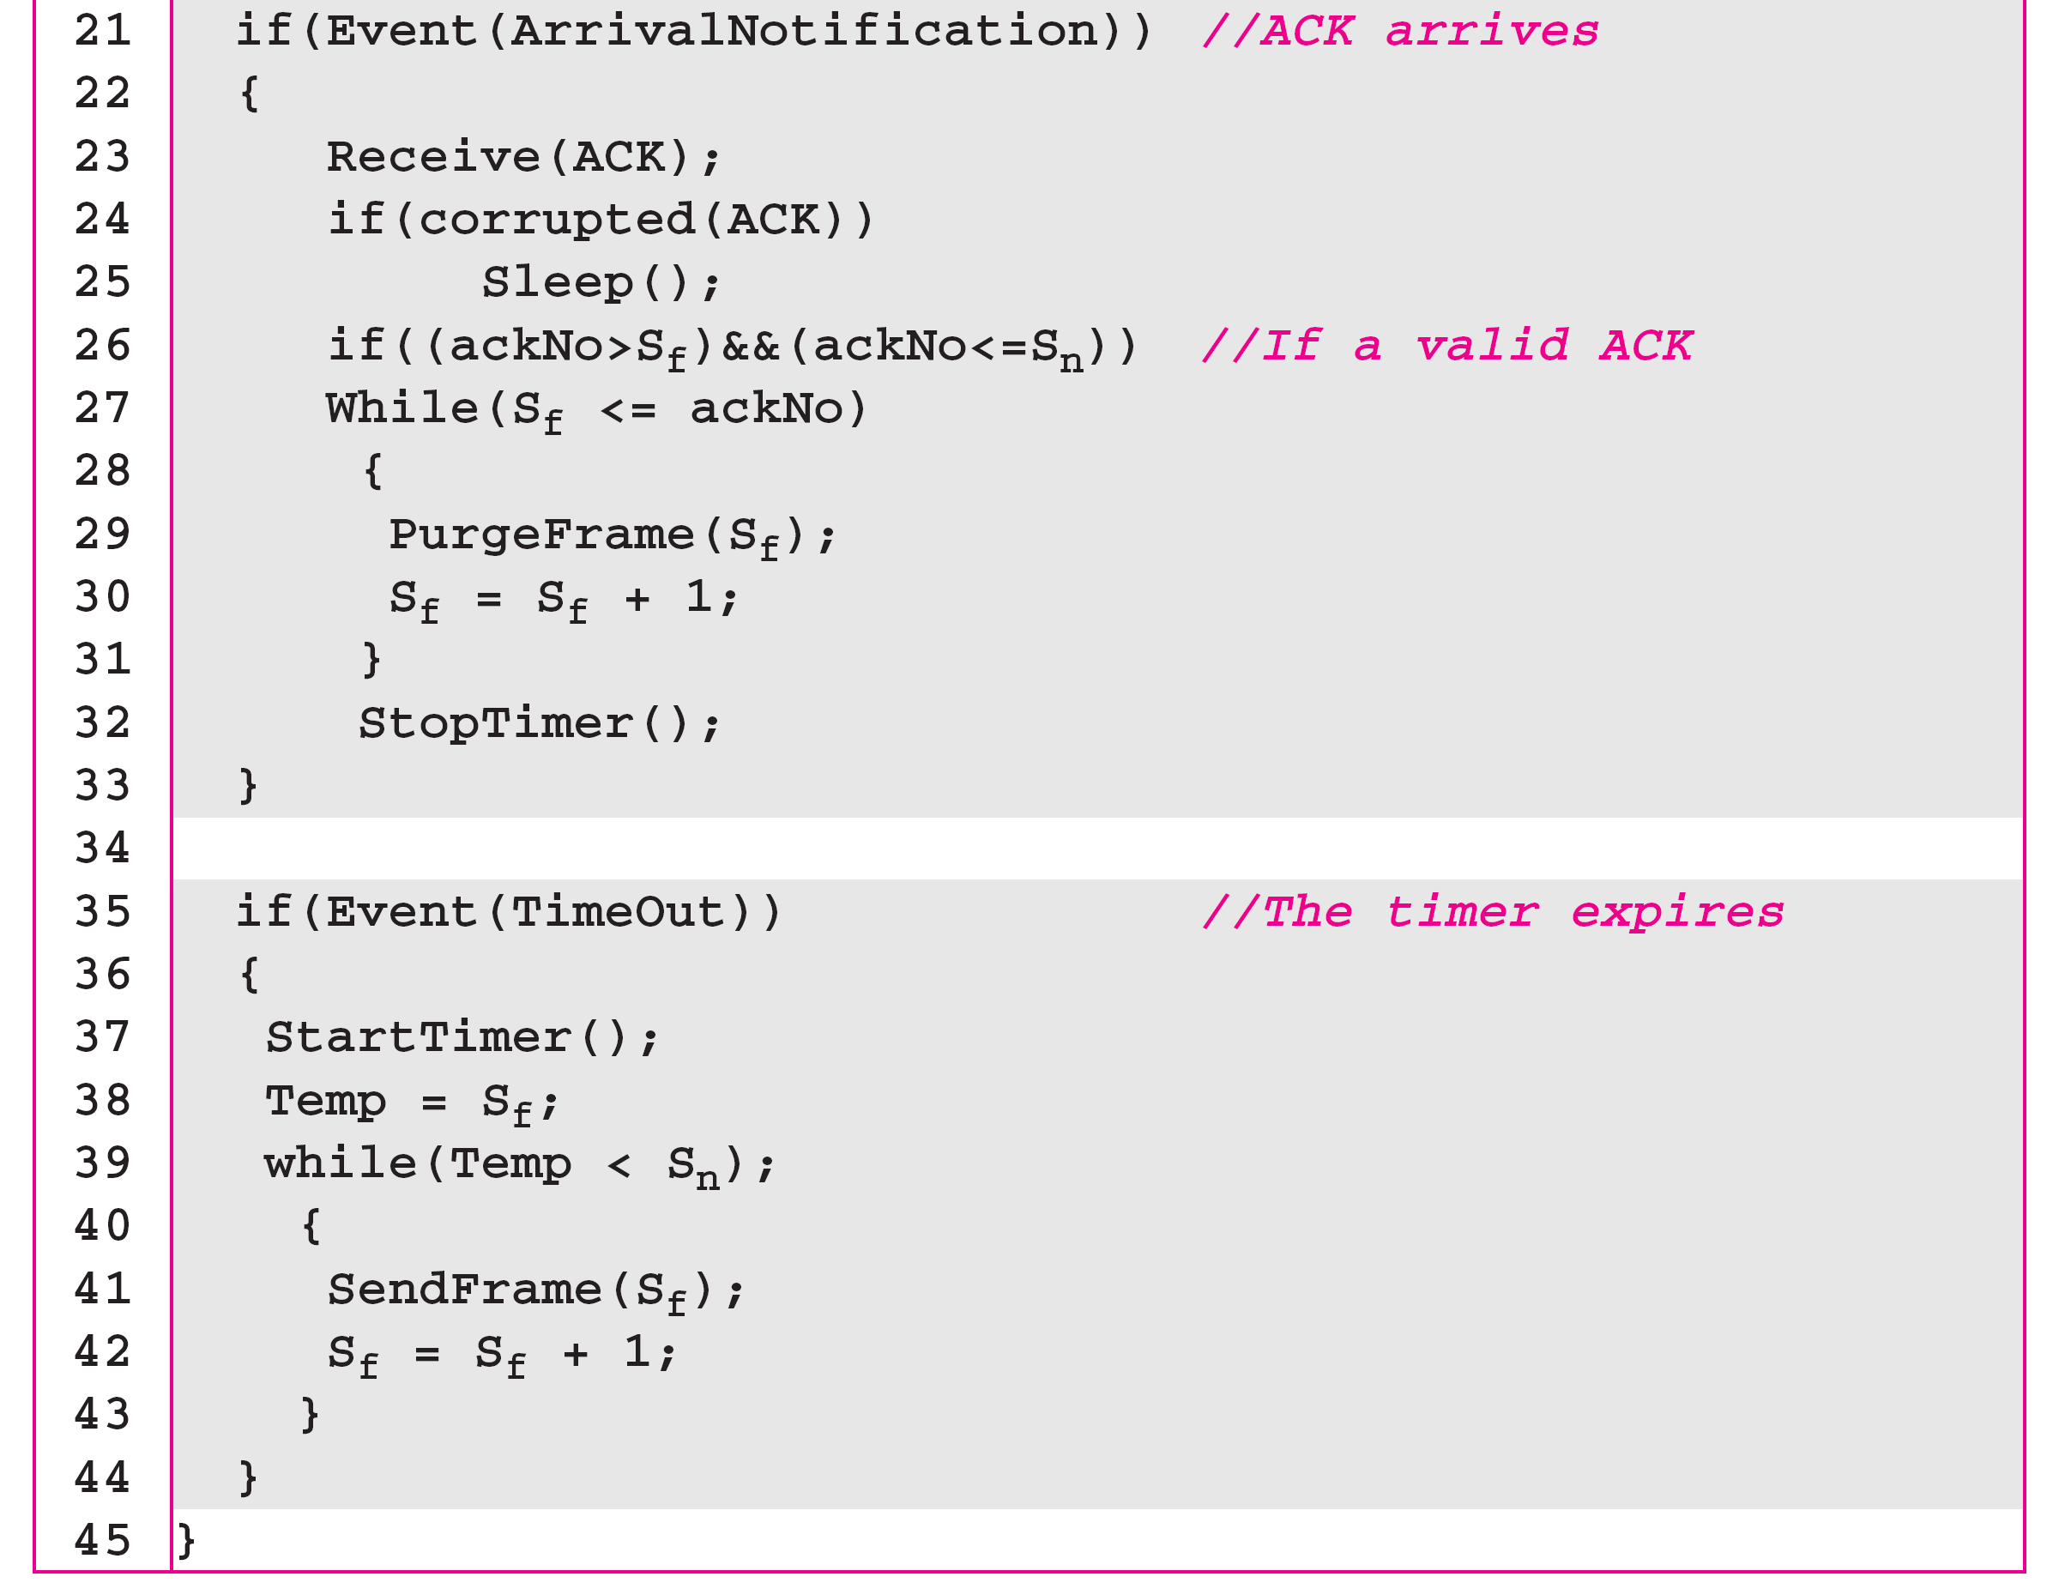
Algorithm 11.7 Go-Back-N sender algorithm
(continued)
{
If (S_{f} ==S_{n} ) // the window is empty
StopTimer();
Else
StartTimer();
{
Typo in Textbook!
11.<number>

Slide 46
Algorithm 11.8 Go-Back-N receiver algorithm
11.<number>

Slide 47

Figure 11.16 Flow diagram for Example 11.6
Typo in Textbook!
StopTimer
StartTimer
Cumulative acknowledgments can help if acknowledgments are delayed or lost
11.<number>

Slide 48

Figure 11.17 Flow diagram for Example 11.7
Typo in Textbook!
StopTimer
StartTimer
11.<number>

Slide 49
Example 11.7
Figure 11.17 shows what happens when a frame is lost. Frames 0, 1, 2, and 3 are sent. However, frame 1 is lost. The receiver receives frames 2 and 3, but they are discarded because they are received out of order. The sender receives no acknowledgment about frames 1, 2, or 3. Its timer finally expires. The sender sends all outstanding frames (1, 2, and 3) because it does not know what is wrong. Note that the resending of frames 1, 2, and 3 is the response to one single event. When the sender is responding to this event, it cannot accept the triggering of other events. This means that when ACK 2 arrives, the sender is still busy with sending frame 3.
11.<number>

Slide 50
Example 11.7 (continued)
The physical layer must wait until this event is completed and the data link layer goes back to its sleeping state. We have shown a vertical line to indicate the delay. It is the same story with ACK 3; but when ACK 3 arrives, the sender is busy responding to ACK 2. It happens again when ACK 4 arrives. Note that before the second timer expires, all outstanding frames have been sent and the timer is stopped.
11.<number>

Slide 51
Example 11.17 shows that because of one packet lost, all following
packets will need to be retransmitted, even if they have arrived at the destination → A great waste of bandwidth
Better protocol: selective repeat ARQ
11.<number>

Slide 52
Selective Repeat ARQ
Problem with Go-back-N:
  Sender: resend many packets with a single lose
  Receiver: discard many good received (out-of-order) packets
  Very inefficient when N becomes bigger (in high-speed network)
Solution: Receiver individually acknowledges all correctly received pkts
  buffers pkts, as needed, for eventual in-order delivery to upper layer
sender only resends pkts for which ACK not received
  sender keeps timer for each unACKed pkt
sender window
  N consecutive seq #’s
  again limits seq #s of sent, unACKed pkts

Slide 53


Figure 11.18 Send window for Selective Repeat ARQ
Figure 11.19 Receive window for Selective Repeat ARQ
11.<number>

Slide 54

Figure 11.23 Flow diagram for Example 11.8
11.<number>

